Slide 1
HACK-AI-THON-2020
TEAM NAME : HOUSTON
TEAM MEMBERS : VIKASH GARG (TEAM LEADER)
ABHINAV ANAND
COLLEGE NAME : SRI VENKATESHWARA COLLEGE OF
ENGINEERING,BANGALORE ,KARNATAKA .

Slide 2
PROBLEM STATEMENT : Video based dynamic human authentication system for access control
PROBLEM DESCRIPTION :
Though there exists a technology for face recognition based authentication, dynamic human recognition based authentication is highly challenging. For a given entrance gate a hardware-software solution is needed to identify every unique person who enters or exit the gate, with log of all previous entry/exit time, photo/videos recorded. That means there will not be a previous history of an individual on the first entry. The system should immediately alert the security if it is a new person and the security will decide to allow/restrict that person entering inside the premises. Whereas, the system should learn from its previous history of videos/images dynamically to allow a known person. For a given size of the gate, the number of cameras with optimal resolution required is also to be worked out as part of solution. The solution should be scalable and preferably based open source.

Slide 3
SOLUTION DESCRIPTION
The process is broken into two steps: (1) face detection and (2) face recognition to identify particular persons.
For the first step, the system tracks and selects the faces of the detected persons.
An efficient recognition algorithm will then be used to recognize detected faces with a known database.
The proposed face recognition algorithm will be used here is Local Binary Patterns Histograms.
This system can be implemented at different restricted areas, such as at the office or house of a suspicious person or at the entrance of a sensitive installation.
The system works almost perfectly under reasonable lighting conditions and image depths.
It is also possible to set up a blacklist of individuals who are regarded as a threat, and to set up alarms or notifications that are triggered when a blacklisted individual appears in front of the camera at the point of access.
We can even keep a record of person entered and exit such as time and date.

Slide 4
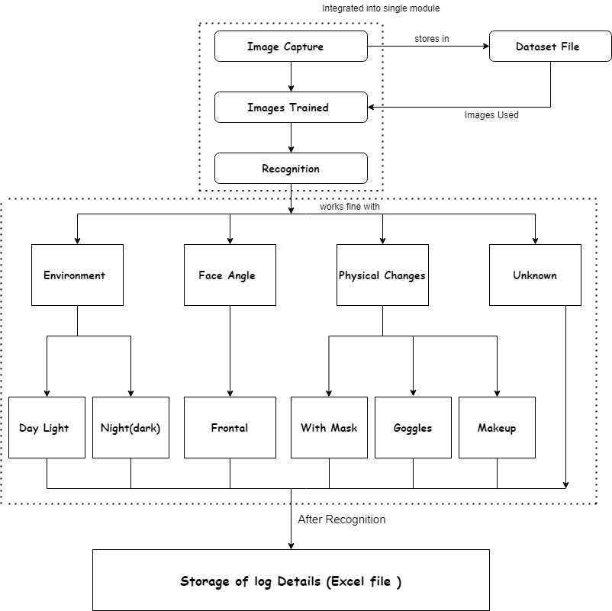
W
O
R
K
F
L
O
W
M
O
D
E
L

Slide 5
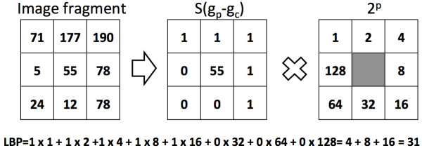
Local Binary Pattern
It defines an ordered set of binary comparison of pixels intensities between the center pixel and its eight surroundings
Used to determine Local Features of the face.
Summarizes the local special structure of an image

Slide 6
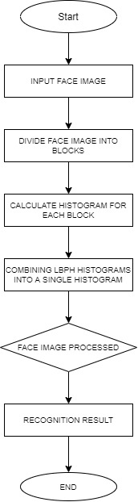
L
B
P
F
L
O
W
C
H
A
R
T

Slide 7
Flow Chart Process
Captures an Image and then stores it
The process will divide the image into several blocks
Histograms will be calculated for each block, then it will be concentrated into a single histogram
As a result, the facial recognition is represented by lbp and the shape of the face is obtained.

Slide 8
Packages Used
tkinter
cvs,os
shutil
csv
numpy
PIL
pandas
datetime
time
random

Slide 9
Multi Person
Recognition

Slide 10
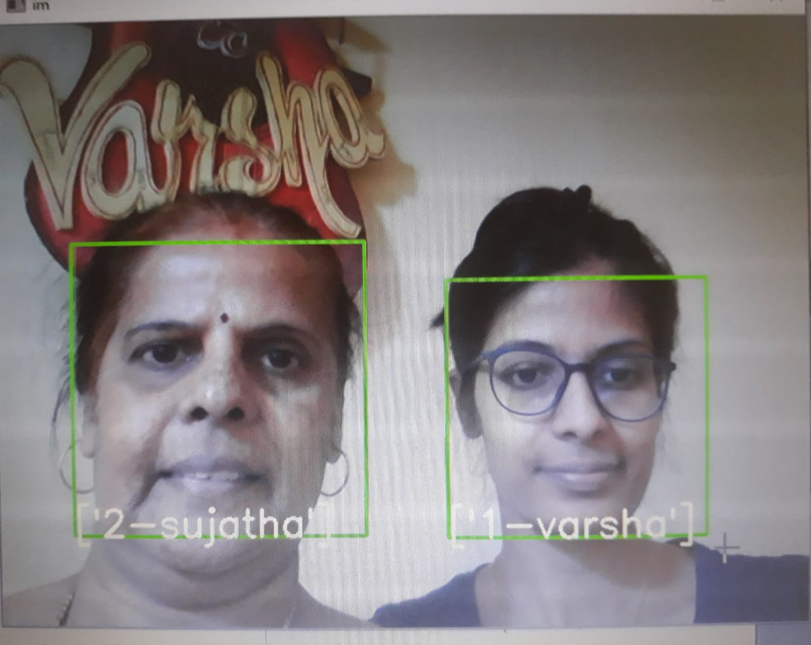
Two Person Detection

Slide 11
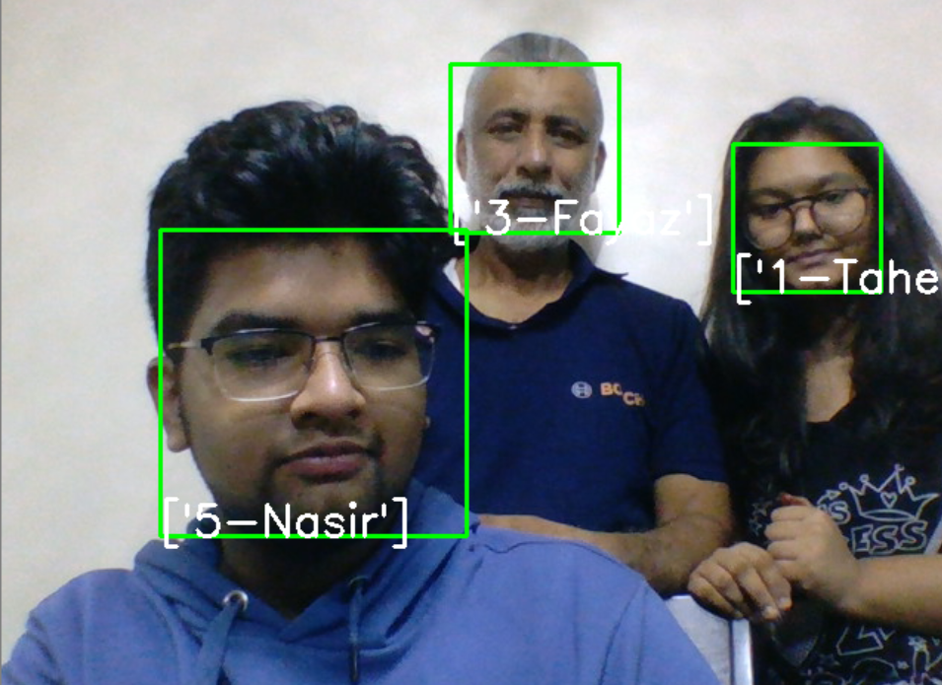
Three Person Detection

Slide 12
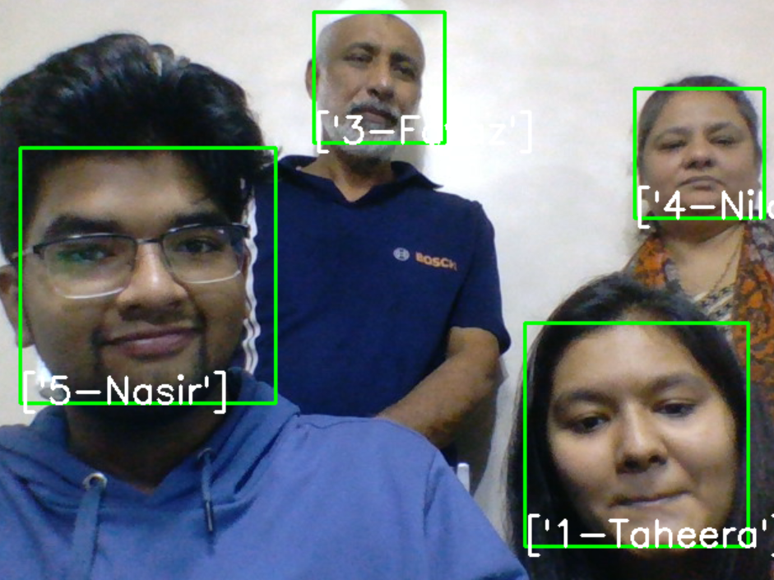
Four Person Detection

Slide 13
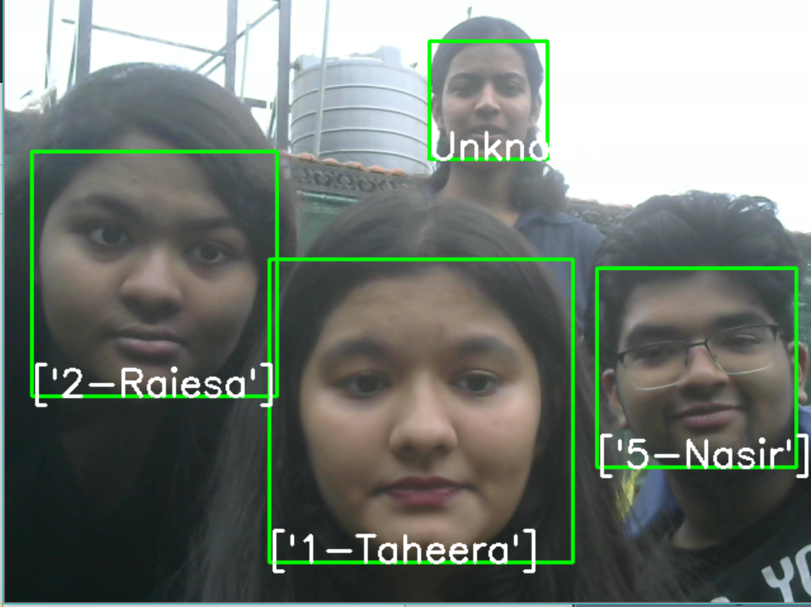
Unknown Person Detection

Slide 14
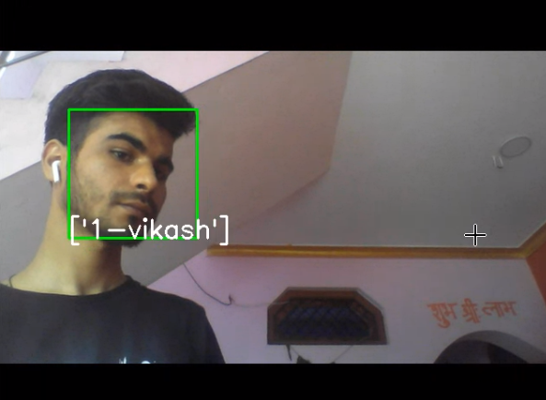
Right Side Profile Detection

Slide 15
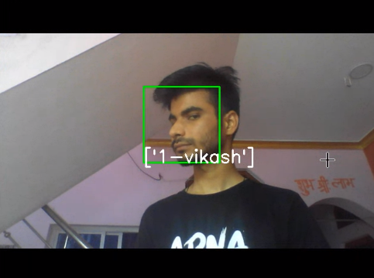
Left Side Profile Detection

Slide 16
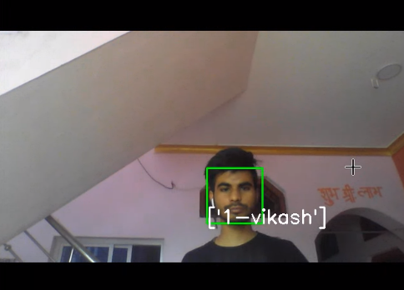
Distance (further away from the camera) Detection

Slide 17
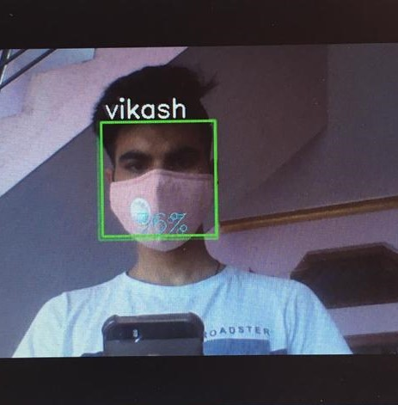
Detection With Mask (1 Person)

Slide 18
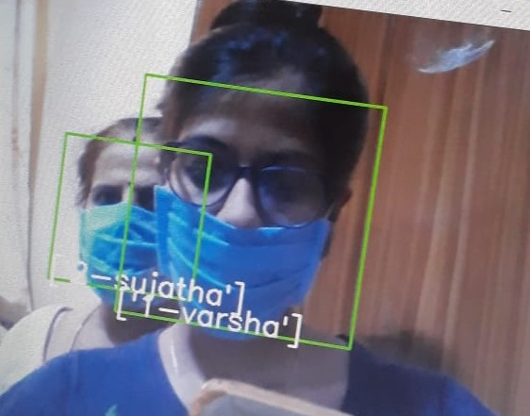
Detection With Mask(2 Person)

Slide 19
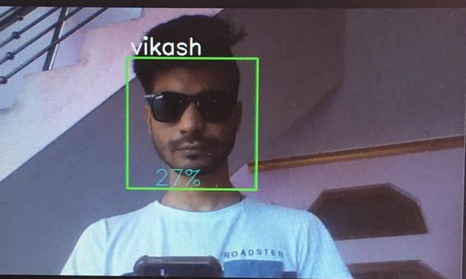
Detection With Goggles

Slide 20
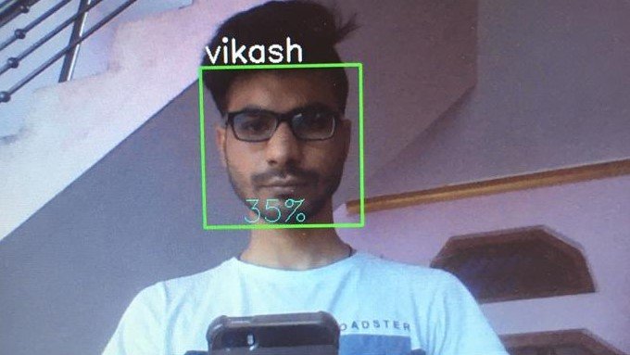
Detection With Spectacle

Slide 21
Webcam Image
Detection

Slide 22
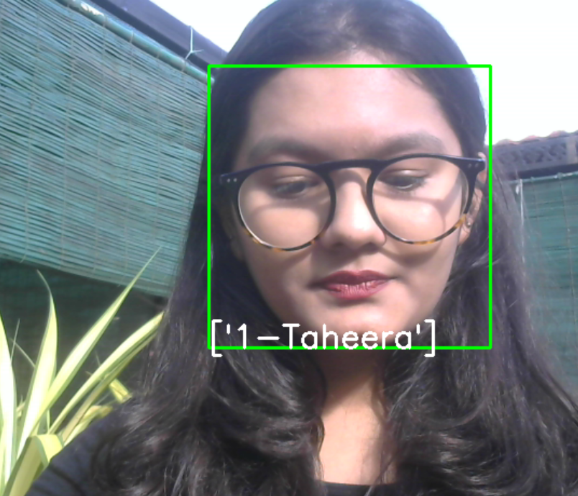
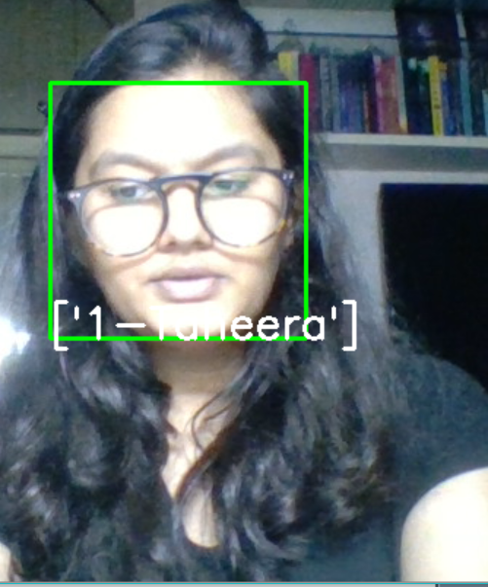
Difference(for 1 person)

Slide 23
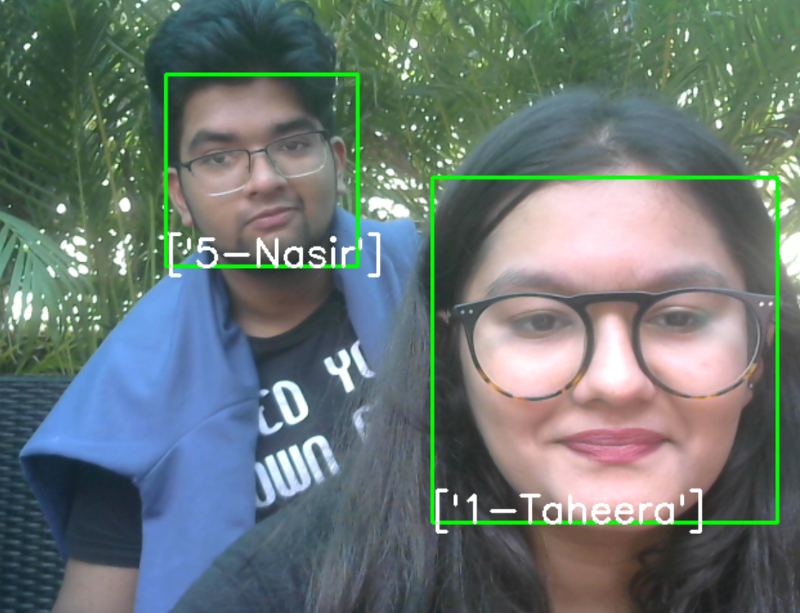
Webcam detection(2 people)

Slide 24
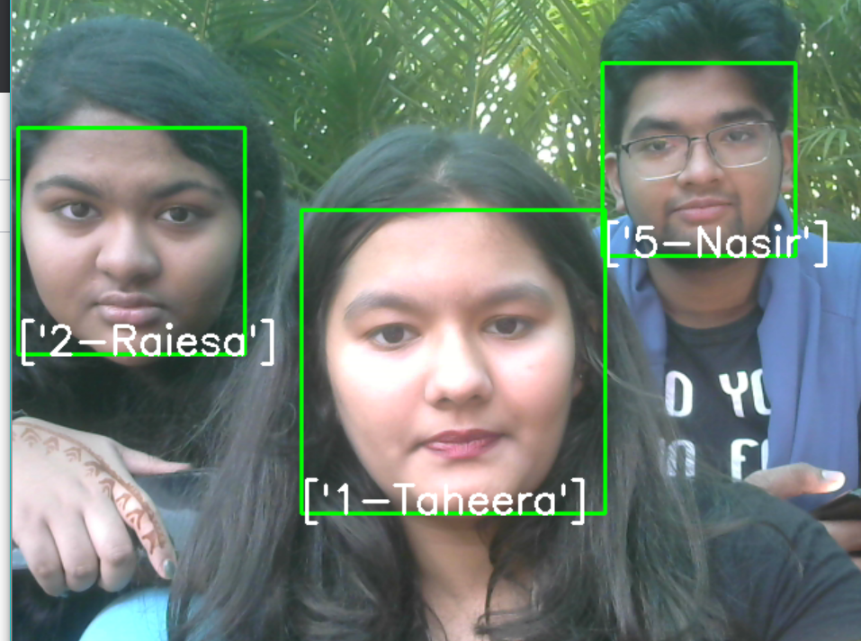
Webcam detection(3 people)

Slide 25
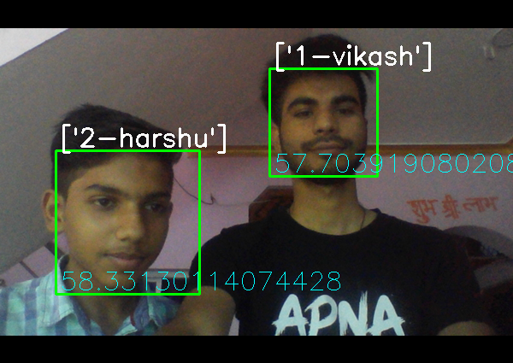
Accuracy (2 people)

Slide 26
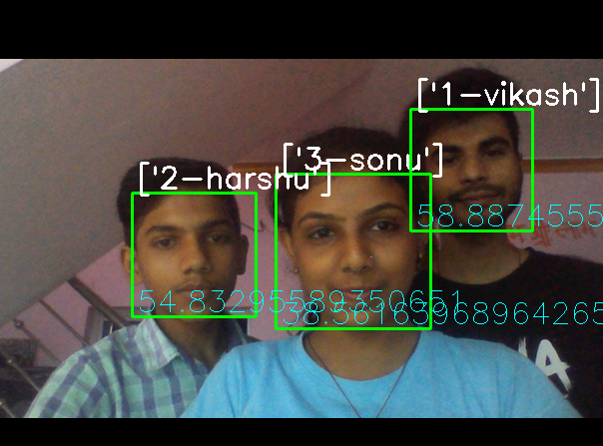
Accuracy(3 people)

Slide 27
ACCESS CONTROL

Slide 28
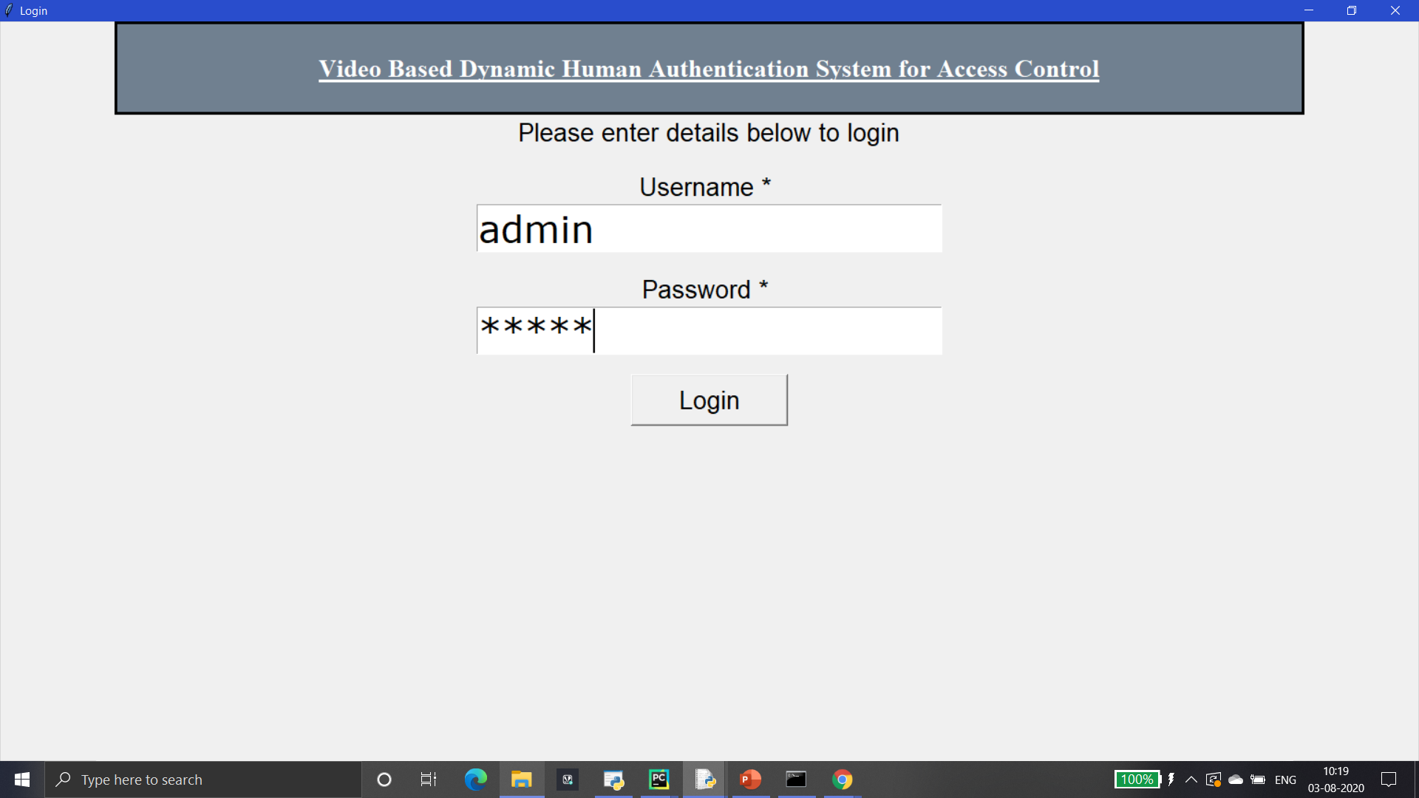
Admin Login Page

Slide 29
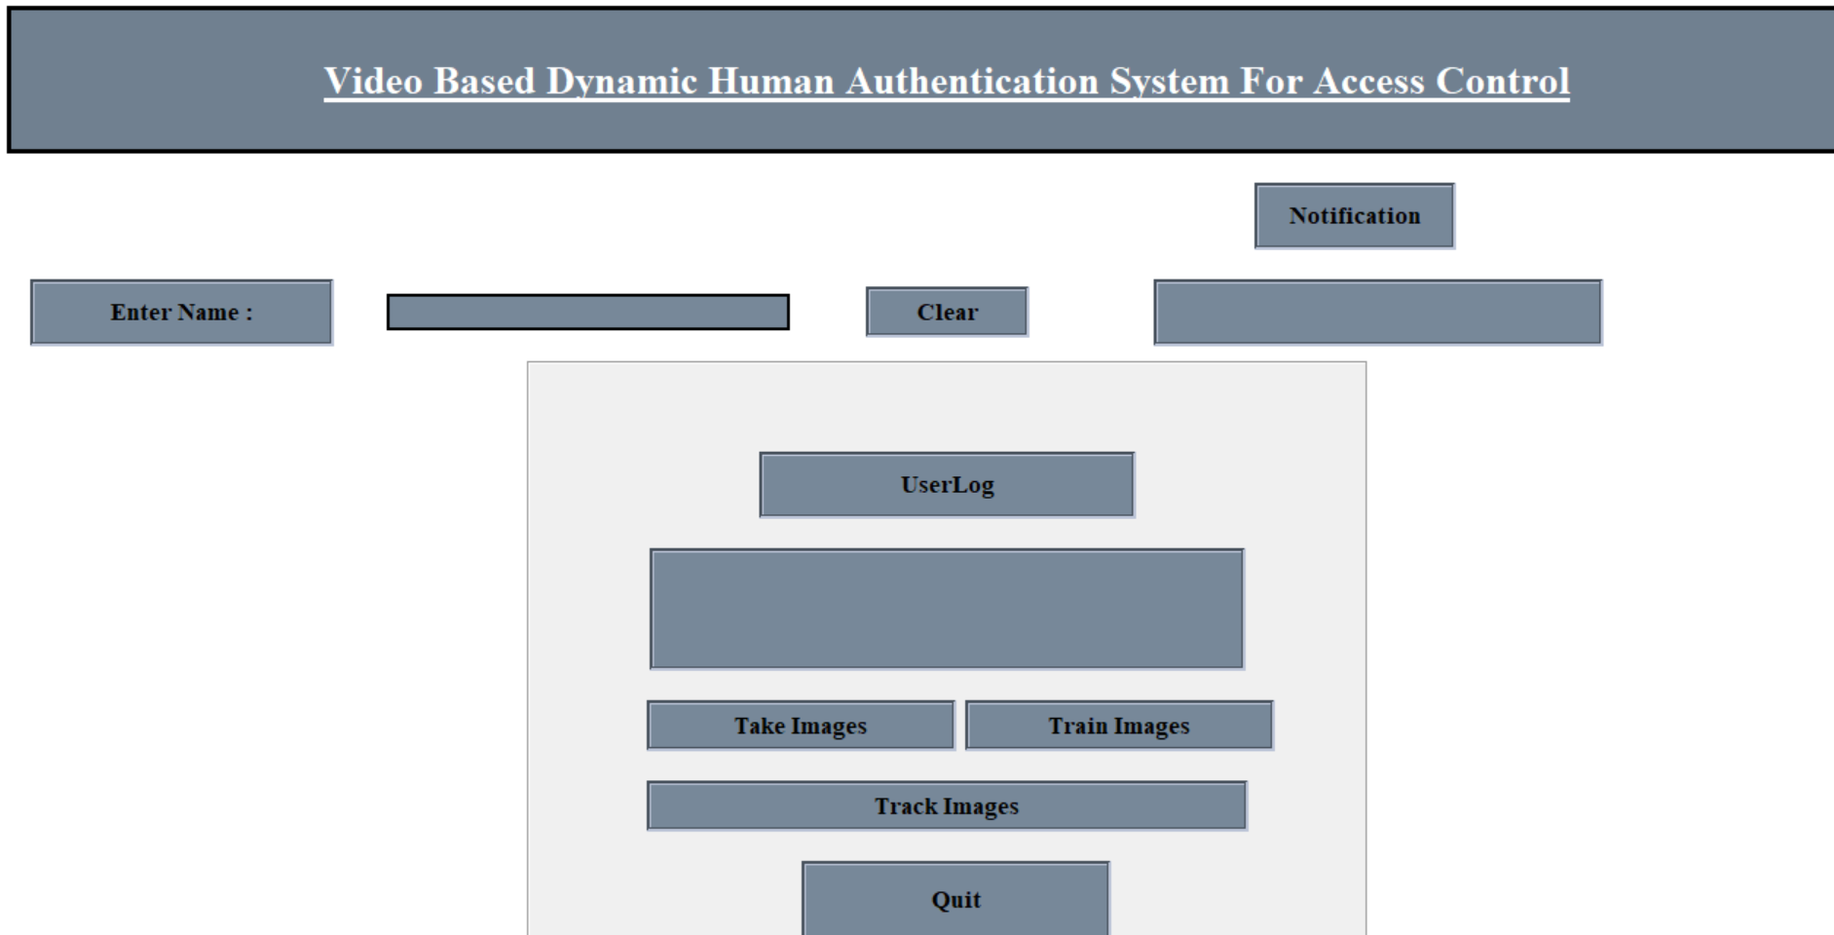
User Interface

Slide 30
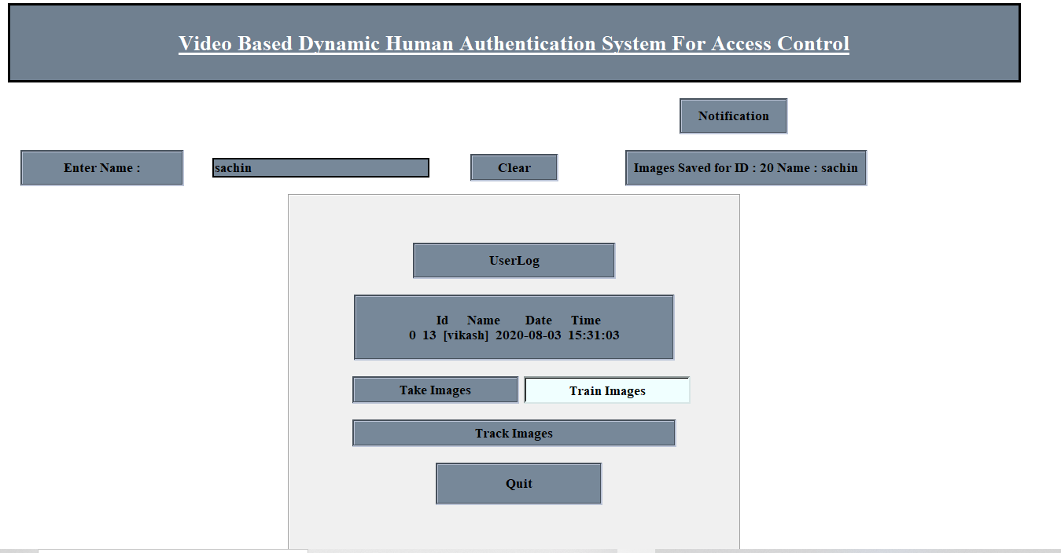
ID GENERATION

Slide 31
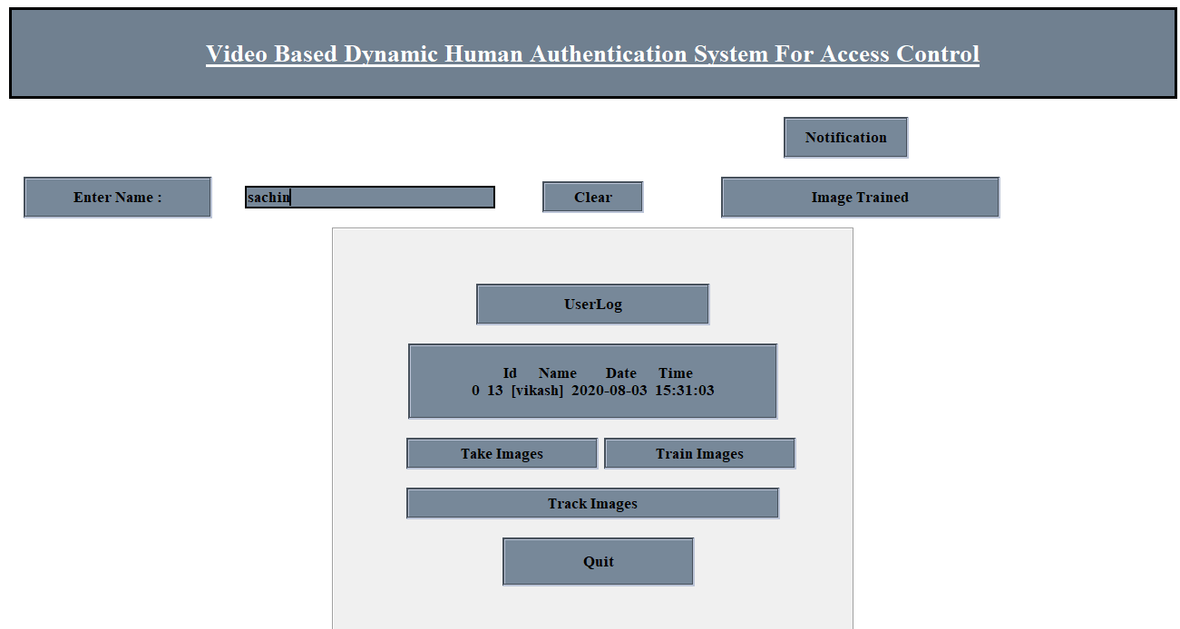
TRAINING OF THE IMAGE

Slide 32
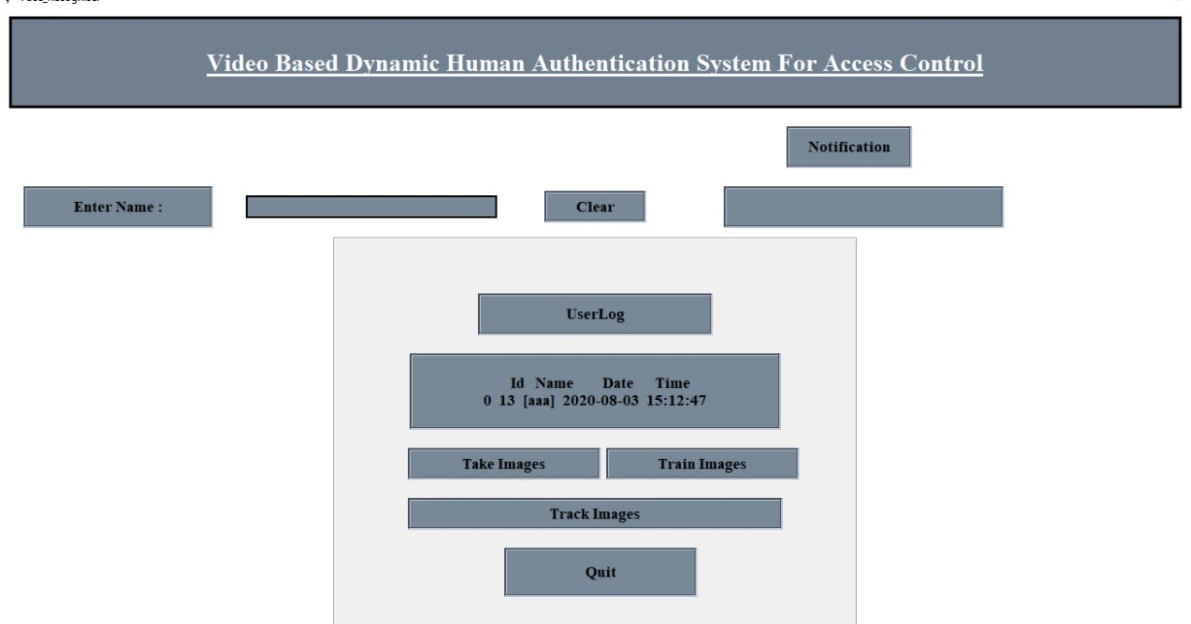
USER LOG

Slide 33
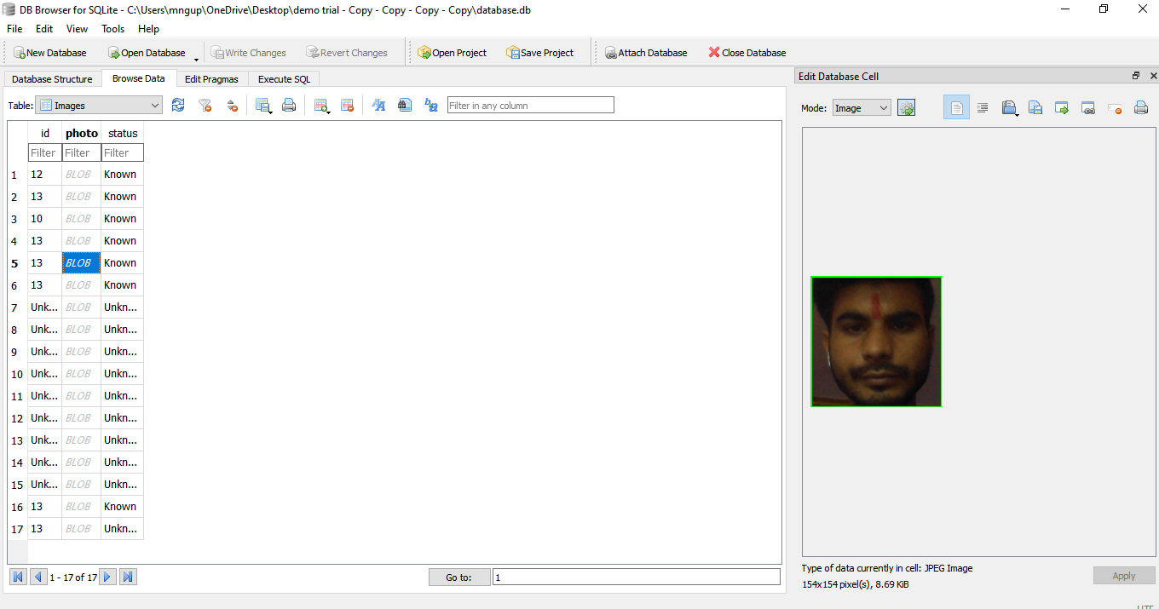
DATABASE IMAGE STORING(known)

Slide 34
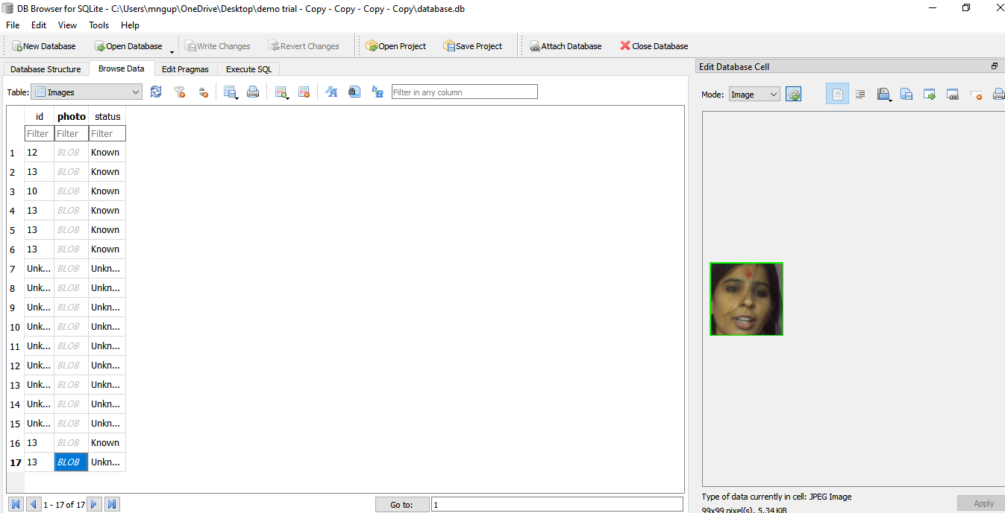
DATABASE IMAGE STORING (unknown)

Slide 35
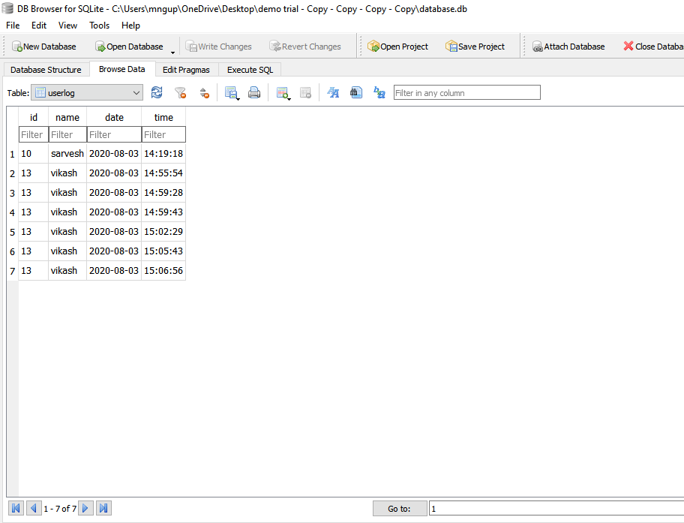
USER LOG (database)

Slide 36

USER INFORMATION

Slide 37
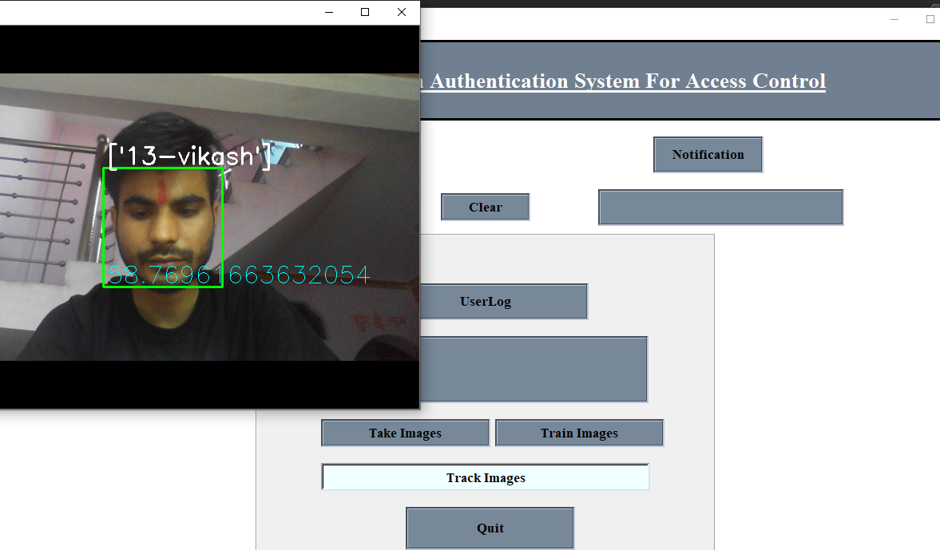
ACCESSING IMAGE FOR DETECTION FROM DATABASE

Slide 38
THANK YOU
-TEAM HOUSTON

